Slide 1
Modeling Interactions and Behavior

Slide 2
Class Diagrams
Build a static model of objects in a system
EmployeeRole
+ getName ()
crewMember
*
*
*
*
*
*
*
Booking
SpecificFlight
0..1
Airplane
*
*
*
*
*
*
Booking ()
*
addLinkToSpecificFlight ()
+ specifyAirplane ()
deleteLinkToSpecificFlight ()
*
+ createFlightLog ()
+ changeAirplane ()
+ findCrewMember ()
0..1
FlightLog
PassengerRole
addLinkToBooking ()
+ makeBooking ()
FlightLog ()
addLinkToBooking ()

Slide 3
Modeling interactions and behavior
We now will focus on modeling system dynamics
  Modeling interactions
    An interaction model shows a set of actors and objects interacting by exchanging messages
  Modeling behavior
    A behavior model shows how an object or system changes state in reaction to a series of event
Notes:
Slide 1: Modeling Interactions and Behavior
English Explanation:
The focus is on dynamic modeling of a system. While static models (like class diagrams) focus on the structure, dynamic models illustrate how parts of the system interact and respond to events.
Interaction modeling shows how actors (users or systems) and objects exchange messages to achieve specific tasks.
Behavior modeling demonstrates how a system or an object reacts to a series of events and transitions between different states.
Additional Info: Dynamic models are crucial in understanding the real-time operations of a system, such as user flows or system responses.

Slide 4
Creating interaction diagrams
  There are two kinds of interaction diagrams:
  Sequence diagrams
  Communication diagrams
Notes:
Slide 2: Creating Interaction Diagrams
English Explanation:
Interaction diagrams can be of two types:
Sequence Diagrams: Focus on the sequence of messages exchanged during a task.
Communication Diagrams: Highlight object collaboration to complete interactions.
Additional Info: Both diagrams help in visualizing system dynamics but are used for slightly different purposes depending on the focus—sequence (order of interactions) vs. collaboration.
Turkish Explanation:
Etkileşim diyagramları iki türdür:
Sıra Diyagramları (Sequence Diagrams): Bir görevi gerçekleştirirken değiş tokuş edilen mesajların sırasını gösterir.
İletişim Diyagramları (Communication Diagrams): Nesnelerin iş birliğini vurgular.
Ekstra Bilgi: Her iki diyagram da sistem dinamiklerini görselleştirmek için kullanılır, ancak odak noktası (sıra veya iş birliği) farklıdır.

Slide 5
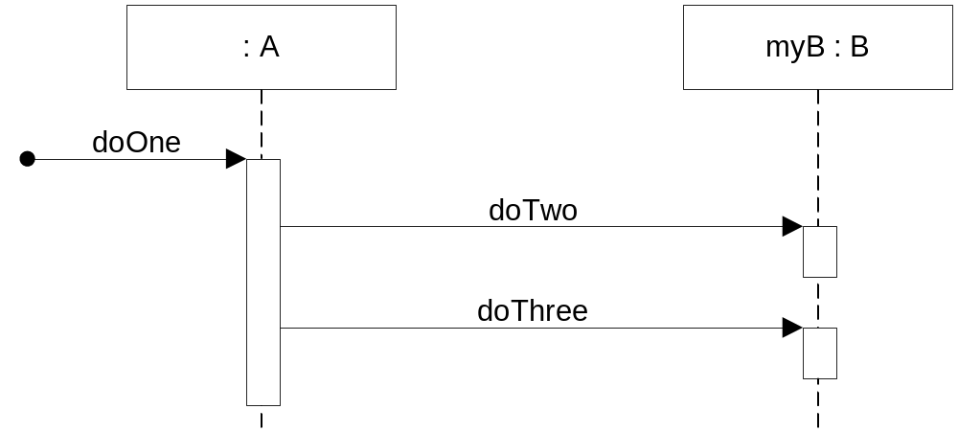
Sequence Diagrams
A sequence diagram shows the sequence of messages exchanged by a set of objects performing a certain task
  The objects are arranged horizontally across the diagram
  An actor that initiates the interaction is often shown on the left
  The vertical dimension represents time
  A vertical line, called a lifeline, is attached to each object or actor
  The lifeline becomes a broad box, called an activation box during the live activation period
Notes:
Slide 3: Sequence Diagrams
English Explanation:
Show the sequence of messages exchanged among objects to complete a task.
Objects are represented horizontally, and time progresses vertically.
Key terms:
Lifeline: Represents the lifetime of an object or actor.
Activation Box: Indicates the time an object is active during the task.
Example: Imagine a shopping cart process—adding an item, calculating the total, and checking out. The sequence diagram would show these messages exchanged in order.
Turkish Explanation:
Nesneler arasında bir görevi tamamlamak için değiş tokuş edilen mesajların sırasını gösterir.
Nesneler yatay olarak yerleştirilir ve zaman dikey olarak ilerler.
Anahtar terimler:
Yaşam Çizgisi (Lifeline): Bir nesnenin veya aktörün yaşam süresini temsil eder.
Aktivasyon Kutusu (Activation Box): Bir nesnenin bir görev sırasında aktif olduğu süreyi gösterir.
Örnek: Alışveriş sepeti işlemini düşünün—ürün ekleme, toplamı hesaplama ve ödeme yapma. Sıra diyagramı bu mesajları sıralı şekilde gösterecektir.

Slide 6
An example Sequence diagram
public class A {
private B myB;
public void doOne() {
...
myB.doTwo();
...
myB.doThree();
...
}
}
public class B {
public void doTwo() { … }
public void doThree() { … }
}

Slide 7
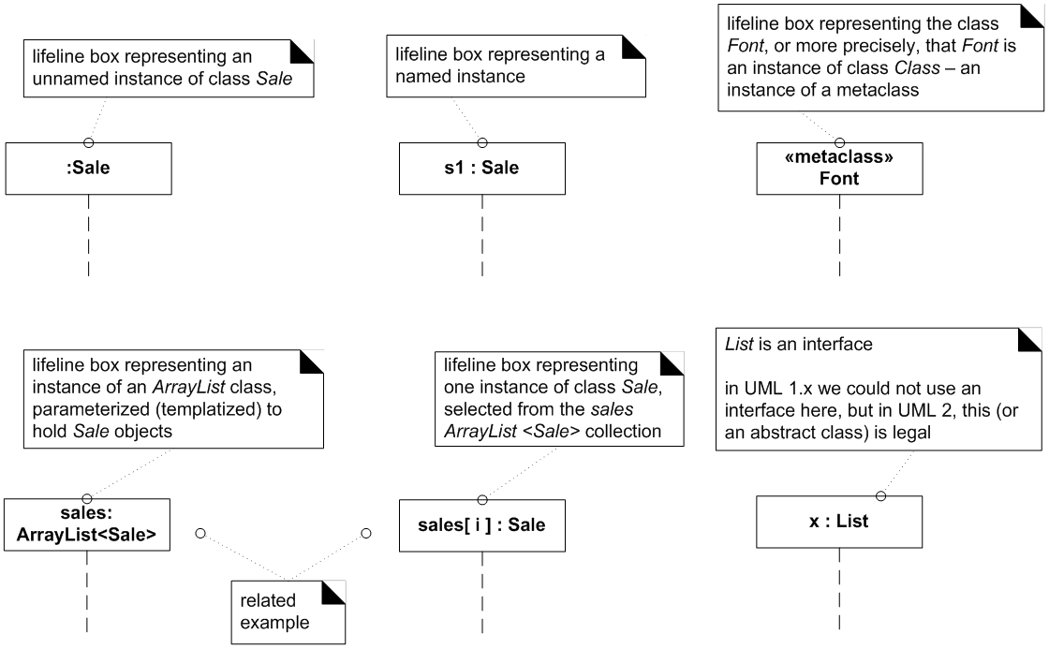
Common interaction diagram notations:
Classes and instances of classes
  Classes and instances of classes
  Instances are shown as boxes with the class and object identifier underlined
    Format: object name: class name
    All the parts except for the `: class name` are optional
  Classes are shown as boxes with the class name
      Not underlined
Notes:
Slide 4: Common Interaction Diagram Notations
English Explanation:
Objects and classes:
Objects are shown with their name and class (underlined).
Classes are represented as rectangles without underlining.
Additional Info: These notations ensure consistency in UML diagrams, making them universally understandable.
Turkish Explanation:
Nesneler ve sınıflar:
Nesneler, adları ve sınıfları (altı çizili) ile gösterilir.
Sınıflar, altı çizilmeden dikdörtgenler olarak gösterilir.
Aktörler: Çöp adam sembolüyle temsil edilir (kullanım durumu diyagramlarından).
Mesajlar: Aktivasyon kutuları arasında oklarla gösterilir; parametreler ve dönüş tipleri isteğe bağlıdır.
Ekstra Bilgi: Bu notasyonlar, UML diyagramlarında tutarlılık sağlar ve diyagramların evrensel olarak anlaşılmasını mümkün kılar.

Slide 8
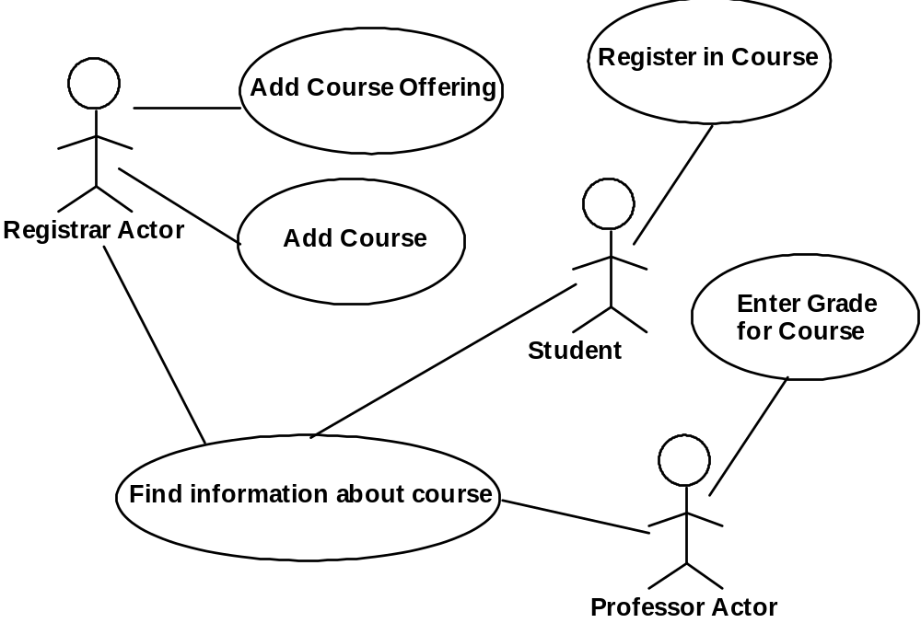
Common interaction diagram notations:
Actors
Actors
  Use the stick-person symbol as in use case diagrams
Notes:
Actors: Represented using the stick figure symbol (from use case diagrams).

Slide 9
Common interaction diagram notations:
Messages
A message is represented as an arrow between activation boxes of the sender and receiver
Message Format
  return = message(parameter : parameterType, …) : returnType
All the parts except for the ‘message’ part are optional, e.g.,
  initialize
  initialize(code)
  d = getProductDescription(id)
  d = getProductDescription(id:ItemID)
  d = getProductDescription(id:ItemID) : ProductDescription
Notes:
Messages: Shown as arrows between activation boxes, with optional parameters and return types.

Slide 10
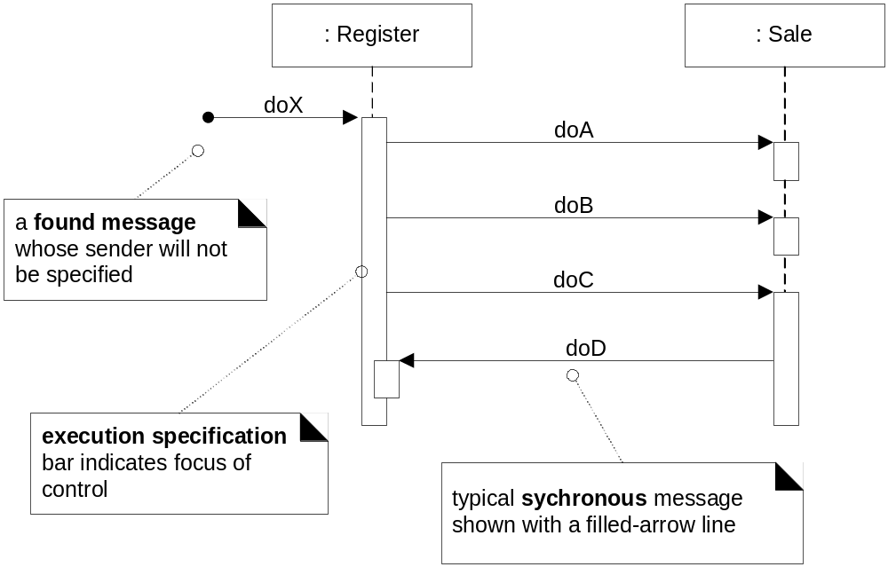
Lifelines, messages, “found” or “starting” messages
Notes:
Slide 5: Lifelines, Messages, and Replies
English Explanation:
Lifelines: Represent the existence of an object or actor over time in a sequence diagram.
They are vertical dashed lines originating from the object's rectangle.
Messages:
Represent communication between objects.
Shown as arrows with optional syntax for return values, parameters, and types.
Replies or Return Values: Can be illustrated in two ways:
With explicit return arrows.
Embedded in the message syntax.
Additional Info: Lifelines and messages help visualize how the system works during specific tasks, especially for debugging or understanding dependencies.
Turkish Explanation:
Yaşam Çizgileri (Lifelines): Sıra diyagramlarında bir nesnenin veya aktörün zaman içindeki varlığını temsil eder.
Nesne kutusundan çıkan dikey kesik çizgiler olarak gösterilir.
Mesajlar:
Nesneler arasındaki iletişimi temsil eder.
Geri dönüş değerleri, parametreler ve türler için isteğe bağlı bir sözdizimi ile oklarla gösterilir.
Yanıtlar veya Dönüş Değerleri:
Açık dönüş oklarıyla gösterilebilir.
Mesaj sözdizimi içinde yer alabilir.
Ekstra Bilgi: Yaşam çizgileri ve mesajlar, bir sistemin belirli görevlerde nasıl çalıştığını görselleştirmek için kullanışlıdır; özellikle hata ayıklamada veya bağımlılıkları anlamada önemlidir.

Slide 11
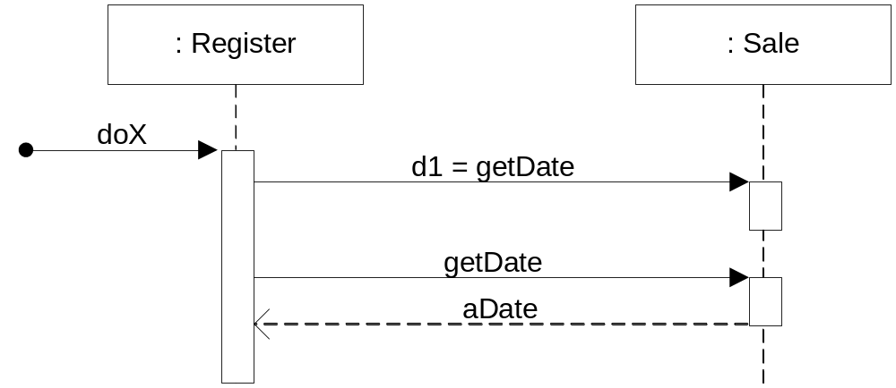
Illustrating replies or return Values
Two alternatives
Using the message syntax
return = message(parameter : parameterType, …) : returnType
Use a reply or return message at the end of an activation bar

Slide 12
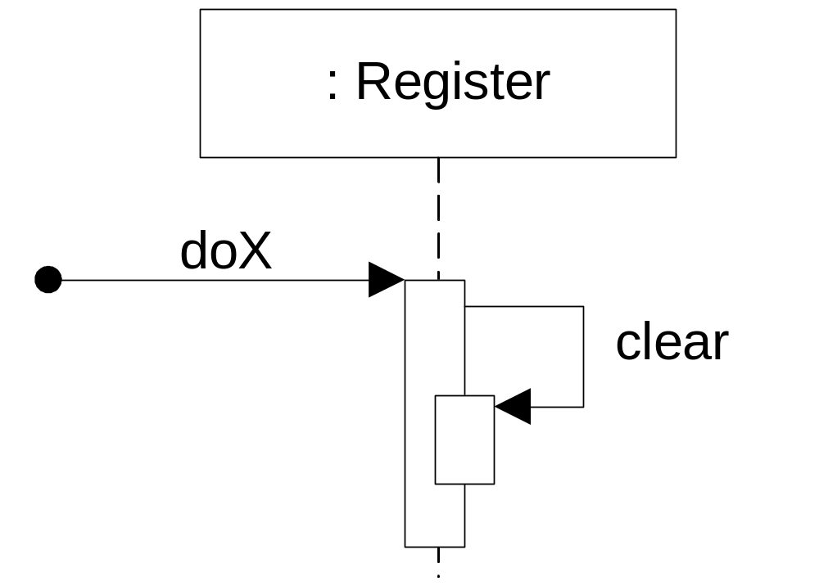
Messages to “self” or “this”
Notes:
Slide 6: Messages to “Self” and Object Creation/Destruction
English Explanation:
Messages to “Self”:
Objects can call their own methods, represented with a looped arrow returning to the same lifeline.
Additional Info: Self-messaging is common in recursive algorithms, and understanding object lifecycle (creation/destruction) is crucial for memory management.
Turkish Explanation:
“Kendine” Mesajlar:
Nesneler kendi metodlarını çağırabilir, bu, aynı yaşam çizgisine dönen bir okla gösterilir.
Nesne Oluşturma:
Yeni nesnenin dikdörtgenine işaret eden kesik bir okla gösterilir.
Nesne Yok Etme:
Bir nesne açıkça yok edilir veya erişilemez hale gelir (örneğin çöp toplayıcı).
Yaşam çizgisinin sonunda bir ‘X’ ile temsil edilir.
Ekstra Bilgi: Kendine mesajlaşma, özellikle özyinelemeli algoritmalarda yaygındır. Nesne yaşam döngüsünü (oluşturma/yok etme) anlamak, bellek yönetimi için kritiktir.

Slide 13
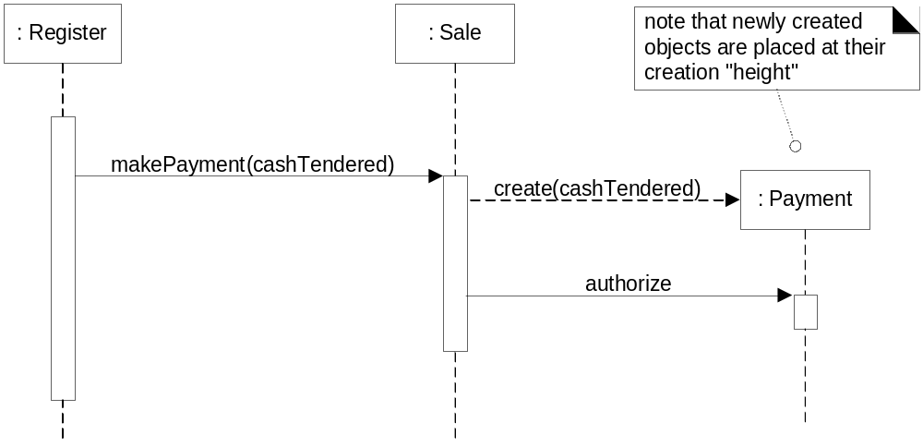
Instance creation
Notes:
Object Creation:
Shown with a dashed arrow pointing to the new object's rectangle.

Slide 14
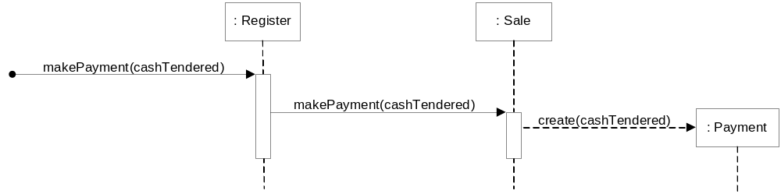
Yet another example
public class Sale {
public void makePayment(Money cashTendered) {
...
Payment payment = new Payment(cashTendered);
...
}
...
}

Slide 15
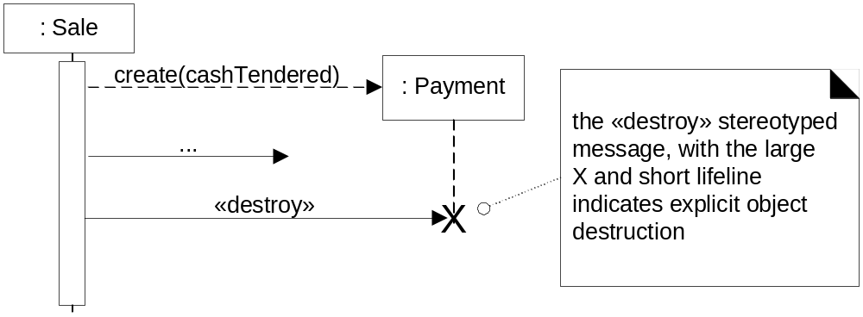
Object destruction
Object explicitly destroyed or no longer usable (reachable)
  Example: No variable refers to object any longer
    Marked for garbage collection
Notes:
Object Destruction:
An object is explicitly destroyed or becomes unreachable (e.g., garbage collection).
Represented with an ‘X’ at the end of the lifeline.

Slide 16
Frames in UML sequence diagrams
Frames are regions or fragments of a sequence diagrams
They indicate a sequence of interactions that is special in someway
They have
  An operator or label (such as loop)
  A guard (conditional clause) which should be placed over the lifeline to which it belongs
Notes:
Slide 7: Frames in UML Sequence Diagrams
English Explanation:
Frames:
Used to represent special conditions or sequences in a diagram.
They include:
Operator/Label: Indicates the type of frame (e.g., loop, alt for alternative conditions).
Guard: A conditional clause above a lifeline, determining whether the sequence will execute.
Example: A “loop” frame for retrying a failed payment process until success.
Additional Info: Frames allow you to manage and depict complex interactions, such as conditional logic or repetitive sequences.
Turkish Explanation:
Çerçeveler (Frames):
Diyagramlarda özel durumları veya dizileri temsil etmek için kullanılır.
Şunları içerir:
Operatör/Etiket: Çerçevenin türünü belirtir (örneğin, döngü, alternatif koşullar için alt).
Koruma (Guard): Bir yaşam çizgisinin üzerinde yer alan ve dizinin çalışıp çalışmayacağını belirleyen koşul.
Örnek: Başarısız bir ödeme sürecini başarıya ulaşana kadar yeniden denemek için bir “loop” çerçevesi.
Ekstra Bilgi: Çerçeveler, koşullu mantık veya tekrarlayan diziler gibi karmaşık etkileşimleri yönetmek ve tasvir etmek için kullanışlıdır.

Slide 17
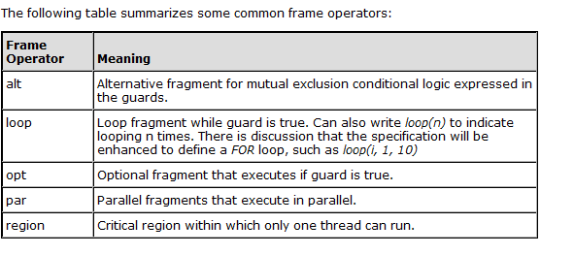
UML supports different types of frames
Notes:
Frame Operators:
alt (Alternative):
Represents mutual exclusion conditional logic. It includes different paths for a given condition.
Example: If a user is authenticated, proceed to the dashboard; otherwise, show an error message.
Key Feature: Conditional branches where only one path executes.
loop:
Represents a repetitive sequence of messages as long as a guard condition is true.
Example: Processing each item in a shopping cart.
Advanced Use: Can define iterations explicitly, e.g., loop(3) for exactly 3 iterations or loop(i, 1, 10) for a range.
opt (Optional):
Indicates an optional fragment that runs only if a guard condition is true.
Example: Displaying a discount message if the user has a discount code.
par (Parallel):
Used for parallel processing where fragments execute at the same time.
Example: Uploading multiple files concurrently.
region:
A critical region where only one thread can execute at a time.
Example: Ensuring thread safety when updating a shared resource like a balance in a banking app.

Slide 18
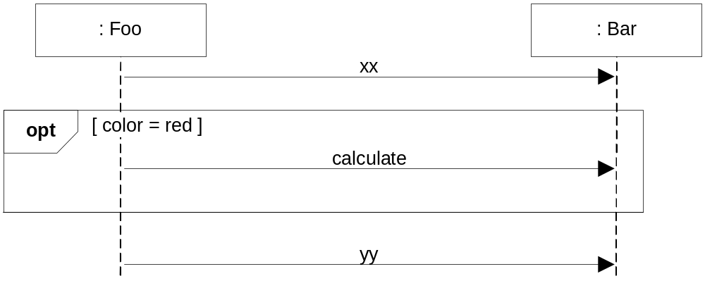
A conditional message
Notes:
Explanation of the Diagram: A Conditional Message
Elements of the Diagram:
Objects (: Foo and : Bar):
These represent instances of classes.
: Foo is the sender object, and : Bar is the receiver object.
Messages (xx, calculate, and yy):
xx: An initial message sent from : Foo to : Bar.
calculate: A conditional message triggered only if the specified condition (color = red) is true.
yy: A message sent after the conditional block regardless of whether the condition was met.
Frame (opt):
Represents an optional fragment.
The guard condition [color = red] determines whether the interaction inside the frame (sending the calculate message) takes place.
Lifelines:
Vertical dashed lines extending from : Foo and : Bar, representing the timeline of the objects' activities.
English Explanation:
This sequence diagram shows a conditional interaction between two objects, : Foo and : Bar.
Flow:
: Foo sends the xx message to : Bar.
If the condition [color = red] is true, the calculate message is sent from : Foo to : Bar.
Regardless of whether the condition is met, the yy message is sent after the optional fragment.
Purpose:
The diagram visualizes a scenario where an action (e.g., a calculation) occurs only under a specific condition. This is useful for modeling real-world logic, like applying discounts in a shopping cart if a user has a coupon.

Slide 19
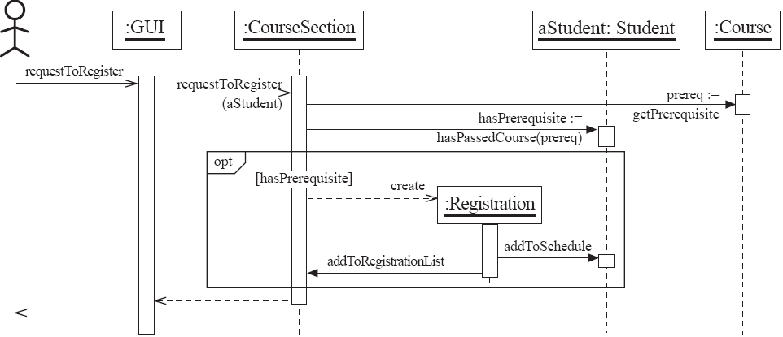
A sequence diagram showing a student registration process
Notes:
Explanation of the Diagram: A Sequence Diagram for Student Registration
Elements in the Diagram:
Actors and Objects:
Actor (Stick Figure): Represents the student (end-user) interacting with the system through the GUI.
Objects:
:GUI: The interface used by the student to request registration.
:CourseSection: Represents the course the student wants to register for.
aStudent: Student: The student attempting registration.
:Course: The course associated with prerequisites.
:Registration: A new registration object created when prerequisites are satisfied.
Messages:
requestToRegister: Initiates the registration process from the GUI to the CourseSection.
getPrerequisite: A request to fetch the course prerequisite.
hasPassedCourse: Checks if the student has completed the prerequisite.
Conditional Message:
opt [hasPrerequisite]: If the student meets the prerequisite, a Registration object is created.
addToRegistrationList: Adds the registration to the course’s list.
addToSchedule: Updates the student’s schedule.
Lifelines:
Vertical dashed lines represent the lifetimes of the objects and actor during the process.
Frame (opt):
Represents an optional fragment where the creation of the :Registration object happens only if the hasPrerequisite condition is true.
English Explanation:
This sequence diagram models the process of a student registering for a course:
The student initiates the registration through the GUI (requestToRegister).
The CourseSection checks if the course has a prerequisite by interacting with the :Course object.
If the prerequisite exists, the system verifies whether the student has completed it (hasPassedCourse).
If the condition is satisfied, a Registration object is created, added to the course's registration list, and updated in the student's schedule.
Purpose: This diagram illustrates a complex flow involving multiple objects and decisions. It ensures all steps are accounted for, including conditional logic for prerequisites.

Slide 20
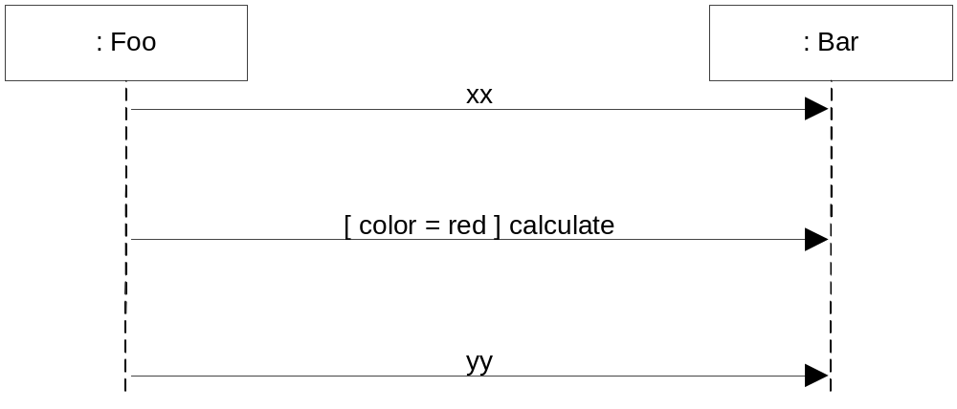
UML Version 1 notation for conditional messages

Slide 21
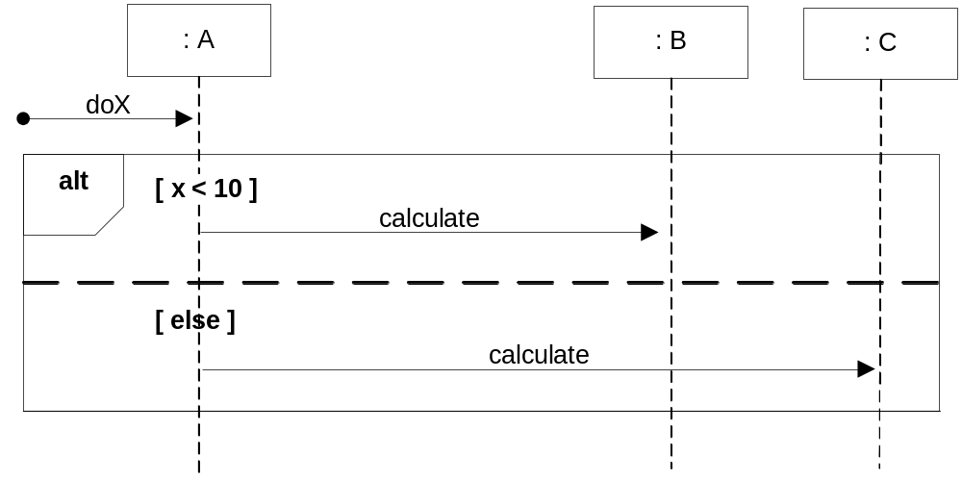
Mutually exclusive conditional messages
Notes:
Diagram 1: Mutually Exclusive Conditional Messages
Elements and Explanation:
Objects (:A, :B, :C):
:A initiates the process (doX).
:B and :C are involved in mutually exclusive actions based on a condition.
Frame (alt):
Represents alternative paths where only one branch executes depending on the condition.
Conditions:
[x < 10]: If the condition is true, the calculate message is sent to :B.
[else]: If the condition is false, the calculate message is sent to :C.
English Explanation:
This sequence diagram shows a decision-making process where the flow diverges based on the condition (x < 10). The alt frame ensures mutual exclusivity—either :B or :C will receive the calculate message, but not both.
Example: In a grading system:
If the score is below 10, assign a tutor (:B).
Otherwise, notify the supervisor (:C).

Slide 22
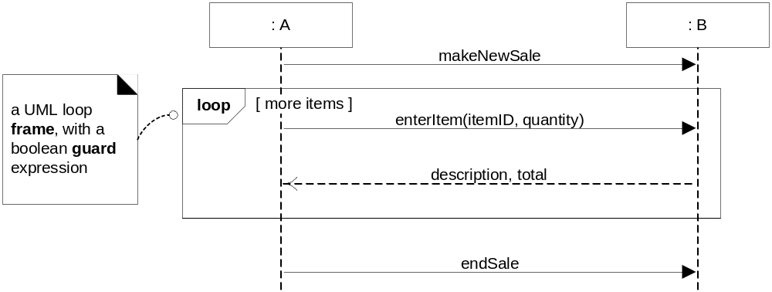
Looping notation
Notes:
Diagram 2: Looping Notation
Elements and Explanation:
Objects (:A, :B):
:A initiates the sale process and interacts with :B.
Frame (loop):
Represents repetition of a set of actions while the condition [more items] is true.
Messages:
makeNewSale: Starts a new sale process.
Loop Messages:
enterItem(itemID, quantity): Adds an item to the sale.
description, total: Returns the item description and running total.
endSale: Completes the sale after exiting the loop.
English Explanation:
This sequence diagram models a repetitive process of adding items to a sale. The loop continues as long as there are more items ([more items]). After all items are entered, the sale is completed with endSale.
Example: A checkout process:
A cashier scans items (enterItem).
The system updates the total and shows the description.
When all items are scanned, the sale ends.

Slide 23
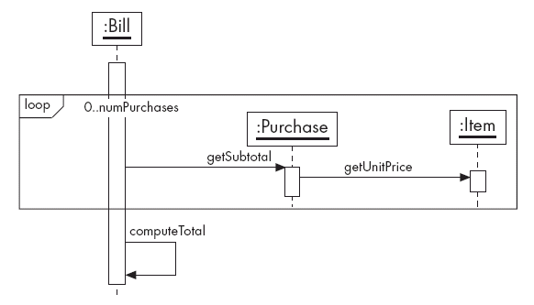
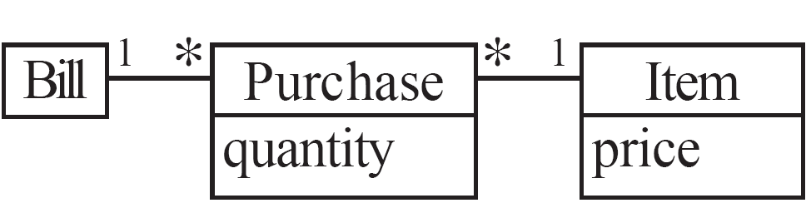
Looping notation
1
Notes:
Diagram 1: Looping Notation with Objects :Bill, :Purchase, and :Item
Elements and Explanation:
Objects:
:Bill: The primary object controlling the process.
:Purchase: Represents individual purchase entries.
:Item: Represents the items involved in each purchase.
Loop Frame:
The loop frame iterates over numPurchases, processing each :Purchase object in the list.
Messages:
getSubtotal: Requests the subtotal for a purchase.
getUnitPrice: Fetches the unit price of an item.
computeTotal: After the loop, computes the total cost by aggregating all subtotals.
Class Diagram:
Shows the relationships:
Bill is associated with multiple Purchase objects.
Each Purchase references multiple Item objects.
English Explanation:
This diagram represents a billing process where a Bill object calculates the total cost. It loops through purchases, retrieves subtotals and unit prices, and then computes the final total. It is a real-world scenario for retail systems or invoicing tools.

Slide 24
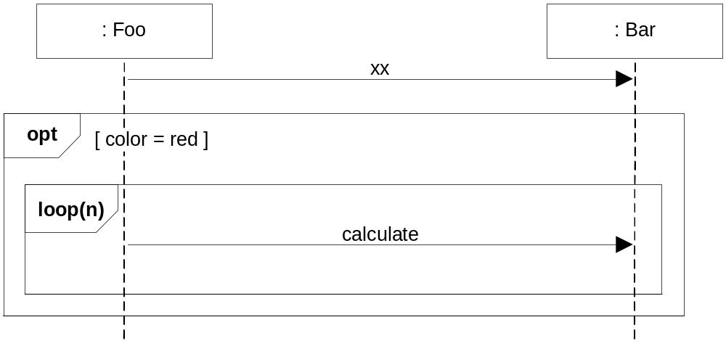
Nested frames
Notes:
Diagram 2: Nested Frames with opt and loop
Elements and Explanation:
Objects:
:Foo: Initiates the process by sending a message to :Bar.
:Bar: The receiver of the interactions.
Frames:
opt [color = red]: The outer frame executes if the condition color = red is true.
loop(n): The inner frame repeats the calculate action n times.
Messages:
xx: A message initiating the interaction.
calculate: The action repeated inside the loop.
English Explanation:
This diagram models a nested condition. If color = red, a calculation is performed multiple times (loop(n)). Such a pattern is useful for iterative processes that depend on a conditional state, e.g., applying discounts on specific products.

Slide 25
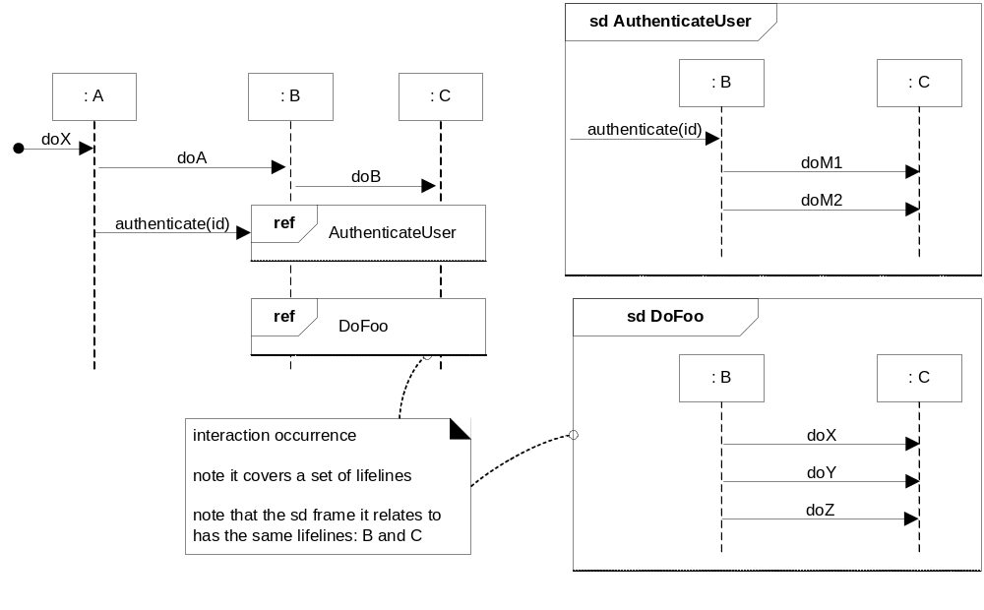
How to relate interaction diagrams (hierarchical notation)
Notes:
We can relate sequence diagrams in a hierarchical manner.
Reference frame. Sequence diagram (sd) frame.
Diagram 3: Relating Interaction Diagrams (Hierarchical Notation)
Elements and Explanation:
Objects:
:A, :B, :C: Represent different components of the system interacting hierarchically.
References:
ref AuthenticateUser: Indicates a detailed sequence diagram (sd AuthenticateUser) that models the authentication process.
ref DoFoo: Refers to another sequence diagram (sd DoFoo) that models additional tasks.
Detailed Diagrams:
sd AuthenticateUser: Shows interactions between :B and :C for user authentication.
sd DoFoo: Details another interaction process with its own flow.
Interaction Occurrence:
Indicates that one sequence diagram (AuthenticateUser) invokes another (DoFoo), covering the same lifelines.
English Explanation:
This diagram illustrates how larger systems can break down complex interactions into smaller, modular sequences. Hierarchical notation makes diagrams readable and manageable by referencing detailed sub-diagrams.

Slide 26
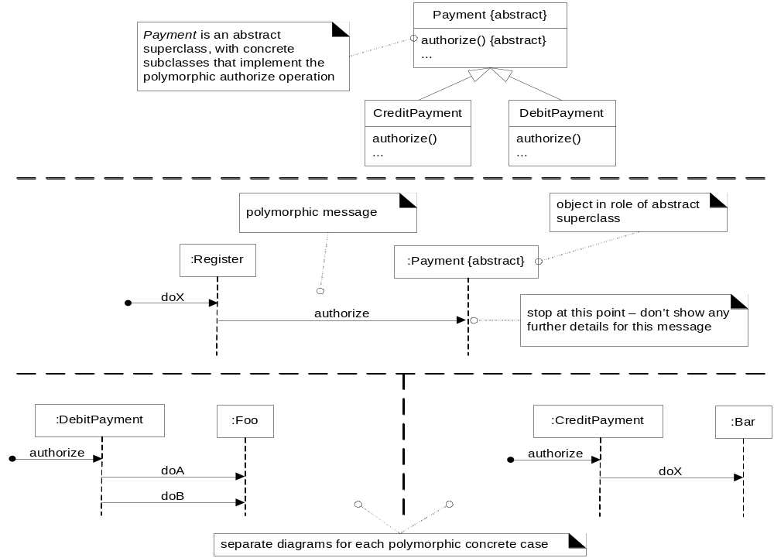
Polymorphic messages and cases
Payment p;
...
p = new CreditPayment();
p = new DebitPayment();
p.authorize();
// DebitPayment.authorize()
// CreditPayment.authorize()
// which one
One approach is to show multiple sequence diagrams, one sequence diagram to show the polymorphic message to the abstract superclass or interface and then separate sequence diagrams detailing each polymorphic case.
Notes:
Polymorphism in UML (Brief Explanation)
Definition:
Polymorphism in UML refers to the ability of different objects (from a hierarchy) to respond uniquely to the same message. It models how a superclass or interface defines a general behavior, but the actual behavior is determined by the specific subclass at runtime.
Slide 8: Polymorphism in Sequence Diagrams
English Explanation:
Polymorphism:
Shows how a polymorphic message (e.g., authorize()) can call different implementations depending on the object type (e.g., CreditPayment or DebitPayment).
One sequence diagram is used for the superclass/interface.
Separate diagrams show the behavior of specific subclasses.
Additional Info: Polymorphism highlights the flexibility of object-oriented design, where objects of different types respond to the same message.
Turkish Explanation:
Polimorfizm:
Polimorfik bir mesajın (authorize()) nesne türüne bağlı olarak farklı uygulamaları nasıl çağırabileceğini gösterir (örneğin, CreditPayment veya DebitPayment).
Üst sınıf/arayüz için bir sıra diyagramı kullanılır.
Belirli alt sınıfların davranışlarını göstermek için ayrı diyagramlar yapılır.
Ekstra Bilgi: Polimorfizm, aynı mesaja farklı nesne türlerinin nasıl yanıt verdiğini göstererek nesne yönelimli tasarımın esnekliğini vurgular.

Slide 27
Polymorphic messages and cases
Notes:
Diagram: Polymorphic Messages and Cases
This diagram illustrates the concept of polymorphism in object-oriented design and how it is represented in UML sequence diagrams. Let’s break it down.
Key Concepts in the Diagram:
Polymorphic Message:
A polymorphic message is sent to an object, but the exact method implementation executed depends on the runtime type of the object.
In this case, the authorize message is sent to an object of type Payment.
Abstract Superclass (:Payment {abstract}):
The Payment object represents an abstract superclass or interface.
The actual object at runtime could be a subclass (e.g., DebitPayment or CreditPayment).
At the superclass level, the behavior of the authorize method is not defined—hence no further details for this message are shown at this point in the diagram.
Concrete Subclasses:
Below the dashed line, separate sequence diagrams show the behavior for each subclass:
:DebitPayment and its associated sequence with :Foo.
:CreditPayment and its associated sequence with :Bar.
Each subclass provides its own implementation of the authorize method:
DebitPayment might authorize a payment using a debit account.
CreditPayment might authorize a payment using a credit card.
Separate Diagrams:
Each concrete subclass has a dedicated diagram to depict its specific behavior.
For example:
DebitPayment interacts with :Foo and sends doA and doB.
CreditPayment interacts with :Bar and sends doX.
English Explanation:
This diagram demonstrates polymorphism, where a single message (authorize) sent to a superclass (Payment) can invoke different behaviors based on the actual subclass (e.g., DebitPayment, CreditPayment).
The first part of the diagram (:Register sending authorize to :Payment) represents the polymorphic call without knowing the specific subclass at this level.
The lower part splits the sequence into detailed diagrams for each subclass, allowing a clear depiction of the differing behaviors.

Slide 28
Asynchronous vs. synchronous messages
Synchronous message: Sender gets blocked until a response has received
Asynchronous message: Sender does not wait for a response
  “It doesn’t block”
  Used in multi-threaded environments
    New threads can be created and initiated
Notes:
Slide 1: Asynchronous vs. Synchronous Messages
Key Concepts:
Synchronous Messages:
The sender waits for a response before proceeding.
Example: Calling a function and waiting for it to complete before continuing execution.
In UML, represented with solid arrows.
Asynchronous Messages:
The sender does not wait for a response.
Execution continues immediately after sending the message.
Common in multi-threaded environments, where multiple tasks run concurrently.
In UML, represented with stick arrows.
English Explanation:
Synchronous messaging is like asking a question and waiting for an answer before proceeding.
Asynchronous messaging is like sending an email—you continue with other tasks while waiting for a reply.
Use Cases:
Synchronous: Critical operations, like database queries.
Asynchronous: Background tasks, like sending notifications.

Slide 29
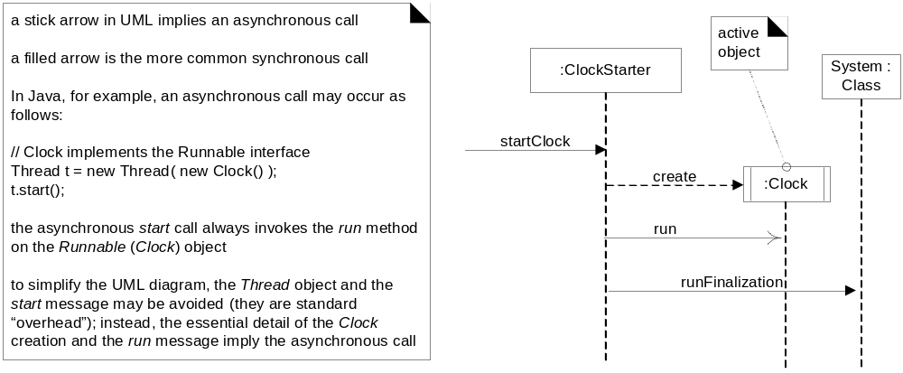
Asynchronous vs. synchronous calls
Active object: Each instance runs on and controls its own thread of execution
  Example: Clock
Notes:
Slide 2: Asynchronous vs. Synchronous Calls in UML
Key Concepts:
Representation in UML:
Stick Arrow: Asynchronous calls.
Solid Arrow: Synchronous calls.
Active Object:
Each instance controls its own thread of execution.
Example: A Clock object that runs independently and performs tasks.
Example:
A startClock message is sent from :ClockStarter to :Clock.
Asynchronous Call:
startClock creates a thread (run method of Clock object is executed).
Allows the calling thread to continue without waiting.
Simplification in UML:
Thread creation and initialization details are often omitted to reduce diagram complexity.
Only essential details (like the run method) are shown.
English Explanation:
The diagram illustrates how asynchronous and synchronous calls are represented in UML.
In multi-threaded environments:
Asynchronous calls let threads execute concurrently, improving efficiency.
For example, a clock application independently tracks time while the main system performs other tasks.

Slide 30
Sequence Diagrams
Interaction diagrams model the dynamic aspects of a software system
  They help you to visualize how the system runs
  They show how a set of actors and objects communicate with each other to perform:
    The steps of a use case, or
    The steps of some other piece of functionality
  An interaction diagram is often built from a use case and a class diagram
    The objective is to show how a set of objects accomplish the required interactions with an actor
Notes:
Slide: Sequence Diagrams
Key Points:
Purpose:
Sequence diagrams are interaction diagrams that model the dynamic behavior of a system.
They help visualize how actors (users/systems) and objects communicate to perform specific actions.
Applications:
Show the steps of a use case.
Illustrate the steps of a specific functionality.
Construction:
Often built from use case diagrams and class diagrams.
Objective: Demonstrate how a group of objects work together to fulfill interactions with an actor.
English Explanation:
Sequence diagrams are used to understand the flow of interactions between objects in a system. They are especially useful for:
Designing or explaining system workflows.
Breaking down complex processes into step-by-step visualizations.
Example: In an e-commerce system, a sequence diagram could show how a user adds items to a cart, makes a payment, and receives a confirmation.

Slide 31
Communication Diagrams
Communication diagrams emphasise how the objects collaborate in order to realize an interaction
  A communication diagram is a graph with the objects as the vertices
  Communication links are added between objects
  Messages are attached to these links
    Shown as arrows labelled with the message name
  Time ordering is indicated by prefixing the message with some numbering scheme
Notes:
Slide 1: Communication Diagrams
Key Points:
Purpose:
Emphasize collaboration between objects to perform an interaction.
Show how objects are linked and how messages flow between them.
Structure:
Represented as a graph where:
Objects are vertices (nodes).
Communication links are edges (connections).
Messages:
Attached to the communication links as arrows labeled with the message name.
Time ordering is represented by numbering the messages.
English Explanation:
Communication diagrams focus on how objects collaborate rather than the sequence of actions. They are useful for understanding relationships and interactions between system components.

Slide 32
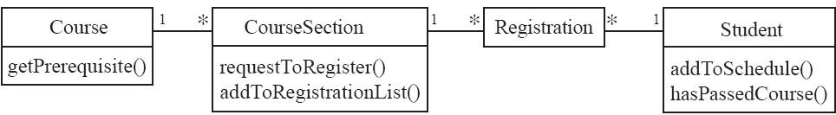
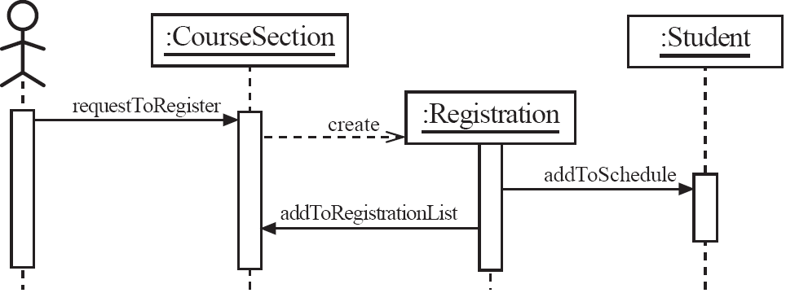
Communication Diagrams
Notes:
Slide 2: Example Communication Diagram
Explanation:
Context: Student course registration.
Objects:
CourseSection: Handles course registration.
Registration: Tracks the student’s enrollment.
Student: The entity being registered.
Course: Provides prerequisite information.
Messages:
requestToRegister: Initiates the registration process.
create: Creates a Registration object.
addToRegistrationList: Adds the student to the course list.
addToSchedule: Updates the student’s schedule.
English Explanation:
This diagram represents the interaction flow for course registration. It visualizes the collaboration among objects (CourseSection, Registration, Student) to complete the process.

Slide 33
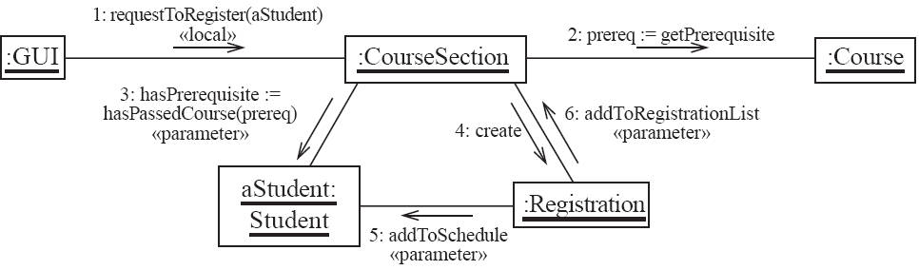
Communication Diagrams – same example, more details
    1. The classes of the two objects have an association between them
      This is the most common case
      If all messages are sent in the same direction, then probably the association can be made unidirectional
Notes:
Breakdown:
Slide 3: Associations Between Objects:
Association: Links between objects like CourseSection and Registration.
If all messages flow in one direction, the association can be unidirectional.

Slide 34
Communication Diagrams – same example, more details
    2. The receiving object is stored in a local variable of the sending method
      This often happens when the object is created in the sending method or when some computation returns an object
      The stereotype to be used is «local» or [L]
Notes:
Slide 4: Local Variables:
A receiving object may be stored as a local variable of the sending method.
Example: CourseSection retrieves a Registration object.

Slide 35
Communication Diagrams – same example, more details
    3. A reference to the receiving object has been received as a parameter of the sending method
      The stereotype is «parameter» or [P]
Notes:
Slide 5: Parameters:
A receiving object can be passed as a parameter to the sending method.
Example: The Student object is passed as a parameter during requestToRegister.

Slide 36
Communication Diagrams – same example, more details
    4. The receiving object is global.
      This is the case when a reference to an object can be obtained using a static method
      The stereotype «global», or a [G] symbol is used in this case
    5. The objects communicate over a network
      We suggest to write «network»
Notes:
Slide 6: Global or Networked Objects:
Global: An object can be accessed via a static method (global stereotype).
Network: Objects communicate over a network, marked as «network».

Slide 37
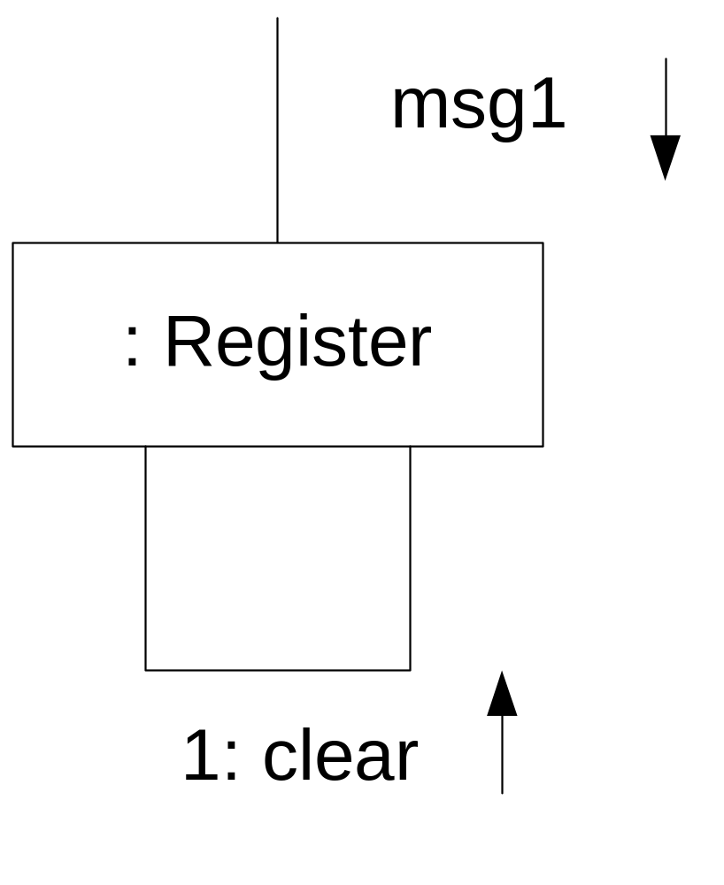
Messages to “self” or “this”
Notes:
Slide 1: Messages to “self” or “this”
Key Points:
Definition:
A message to "self" refers to an object invoking one of its own methods.
In UML communication diagrams, this is represented as a looped arrow returning to the same object.
Example:
The object :Register receives a message (msg1).
It calls its own method clear to perform an action internally.
English Explanation:
Messages to “self” or “this” are commonly used for internal processing. For example:
A class method (clear) might reset internal states after an external call (msg1).
Use Case: This can happen during:
Data cleanup.
Recursive calls (though recursion is better suited for sequence diagrams).

Slide 38
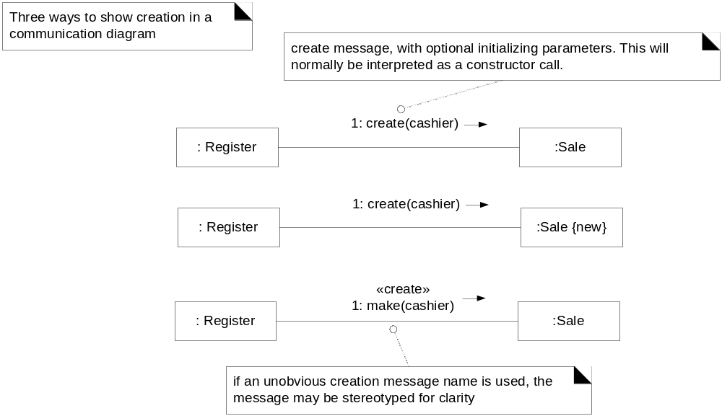
Instance creation in communication diagrams
Notes:
Slide 2: Instance Creation in Communication Diagrams
Key Points:
Definition:
Instance creation is when one object creates another object.
Represented in communication diagrams with a message that triggers the constructor of the new object.
Messages:
Commonly, a method like create or make is used.
Parameters can be passed during creation, such as create(cashier).
Example:
:Register creates an object of type :Sale using the create message.
Notations:
:Sale {new}: Indicates a newly created object.
«create»: A stereotype used to clarify that the message refers to object creation.
English Explanation:
Instance creation in UML diagrams shows how objects dynamically create other objects. For example:
A Register object creates a Sale object during a purchase process.
Use Case:
This is commonly seen in object-oriented systems, such as when creating invoices, logs, or data records.

Slide 39
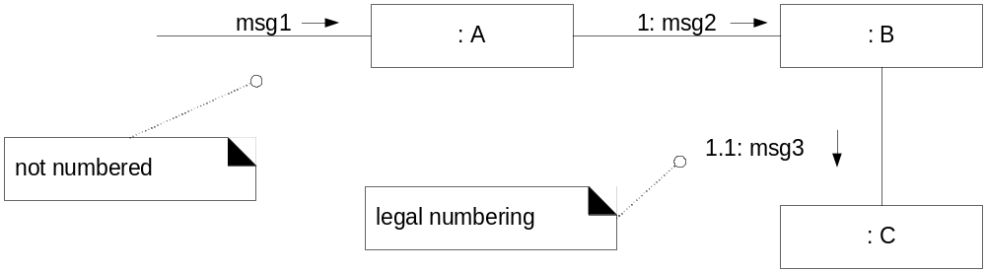
Sequence numbering
Nested message
Notes:
Slide 1: Sequence Numbering (Nested Message)
Key Points:
Purpose:
Sequence numbering is used to show the order of messages in communication diagrams.
Message Numbering:
msg1: A generic unnumbered message (optional in diagrams but not preferred for clarity).
1: msg2: Indicates the first message sent from :A to :B.
1.1: msg3: A nested message, indicating that msg3 is triggered during the execution of msg2.
Key Concept: Nested Messages:
When a message (msg2) triggers another message (msg3), the latter is shown with an incremented sub-number (e.g., 1.1).
English Explanation:
Sequence numbering helps to track the order of execution in complex systems. Nested numbering (e.g., 1.1) indicates a dependent or internal action triggered by another message.

Slide 40
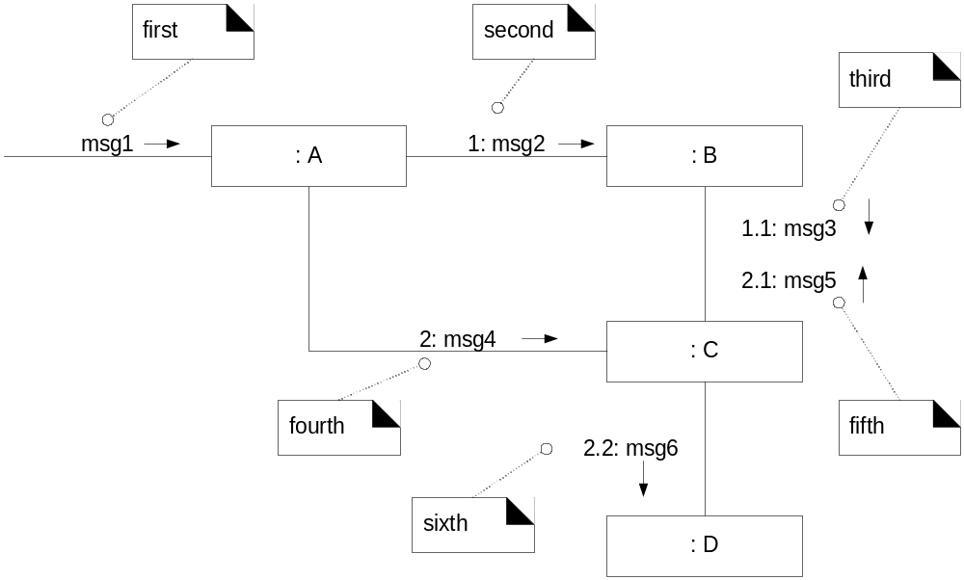
Sequence numbering

Slide 41
Sequence numbering
Notes:
Slide 2: Sequence Numbering (Expanded Example)
Key Points:
Messages in Order:
msg1: A generic message from an external source.
1: msg2: Sent from :A to :B.
1.1: msg3: Triggered by msg2, sent from :B to another object.
2: msg4: A second independent message, sent from :A to :C.
Nested and Independent Messages:
Nested messages are represented as 1.1, 2.1, etc.
Independent messages start a new sequence (e.g., 2).
Complex Flow:
2.2: msg6: Indicates a nested message within the sequence initiated by 2.
English Explanation:
This diagram visualizes a more complex message flow:
Primary messages (e.g., 1: msg2) initiate actions.
Nested messages (e.g., 1.1: msg3) represent tasks dependent on the parent message.
Independent sequences (e.g., 2: msg4) run parallel to other tasks.

Slide 42
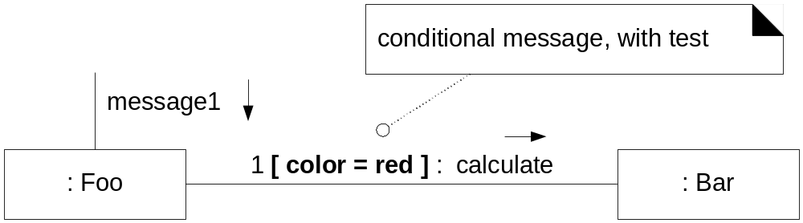
Conditional messages
Notes:
Slide 1: Conditional Messages
Key Points:
Conditional Messages:
Represented with a condition inside square brackets, such as [color = red].
The message is sent only if the condition evaluates to true.
Example:
:Foo sends message1.
If [color = red] is true, :Foo sends the calculate message to :Bar.
English Explanation:
Conditional messages in communication diagrams show decision-based flows. These are used to represent logic like:
"Perform this action only if the condition is met."
Use Case:
A traffic light system: If the light is red, stop the car.

Slide 43
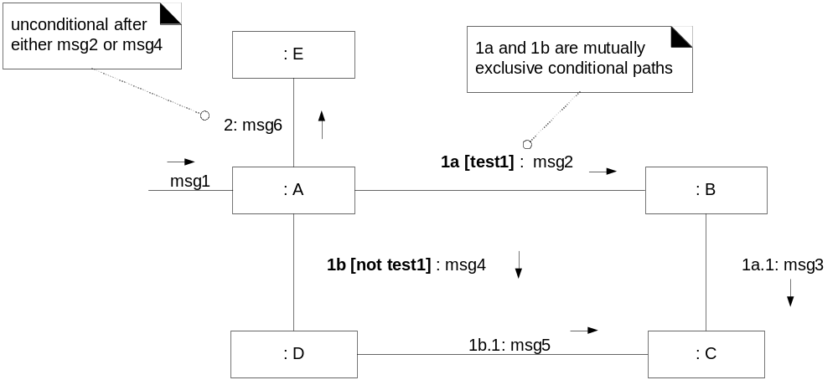
Mutually exclusive conditional messages
Notes:
Slide 2: Mutually Exclusive Conditional Messages
Key Points:
Mutually Exclusive Paths:
Branches are shown with conditions, e.g., 1a [test1] or 1b [not test1].
Only one branch is executed based on the condition.
Example:
If [test1] is true:
msg2 is sent to :B, and then msg3 to :C.
If [not test1] is true:
msg4 is sent to :D, followed by msg5.
Unconditional Follow-Up:
After either path completes, msg6 is sent to :E
English Explanation:
Mutually exclusive paths show decision-based branching:
Useful in systems where actions depend on conditions.
After completing one branch, the flow can return to a shared step.
Use Case:
Login validation:
If credentials are valid, grant access.
If not, display an error.

Slide 44
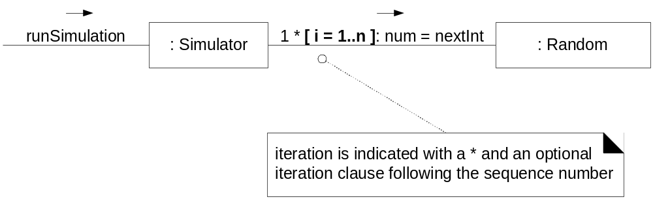
Iteration in communication diagrams
Notes:
Slide 3: Iteration in Communication Diagrams
Key Points:
Iteration Representation:
Asterisk (*) denotes repetition.
Optional iteration condition (e.g., [i = 1..n]) specifies the range or criteria.
Example:
:Simulator calls nextInt on :Random multiple times.
The iteration [i = 1..n] indicates the loop executes n times.
English Explanation:
Iteration in communication diagrams models repetitive actions:
It highlights loops or repeated interactions between objects.
Use Case:
A simulation running for n iterations, such as generating random numbers for a weather model.

Slide 45
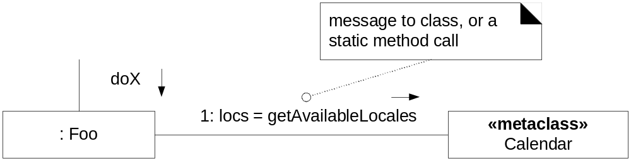
Static method invocation (message to a class)
Notes:
Slide 1: Static Method Invocation (Message to a Class)
Key Points:
Static Method Invocation:
A static method is a method that belongs to the class, not an instance of the class.
In the diagram, getAvailableLocales is called directly on the Calendar class.
Diagram Details:
:Foo sends the message doX.
As part of this action, Foo calls the getAvailableLocales method on the Calendar class (static method).
English Explanation:
Static methods are class-level methods and do not require an instance of the class. This is commonly used for utility functions like retrieving configuration details, constants, or global settings.
Example:
Math.sqrt() in Java is a static method that calculates the square root without needing an object.

Slide 46
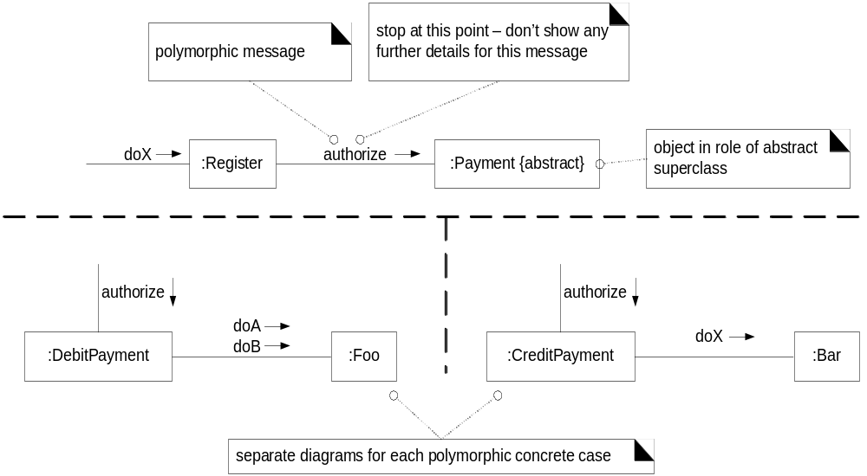
Modeling polymorphic cases in communication diagrams
Notes:
Slide 2: Modeling Polymorphic Cases in Communication Diagrams
Key Points:
Polymorphic Messages:
A polymorphic message like authorize is sent to a generic object (Payment).
The actual implementation depends on the runtime type (DebitPayment or CreditPayment).
Diagram Details:
:Register sends authorize to :Payment {abstract} (abstract class or interface).
Depending on the subclass:
DebitPayment executes methods doA and doB.
CreditPayment interacts with :Bar.
English Explanation:
Polymorphism allows the same message to invoke different behaviors based on the object's type. This is useful for designing extensible systems where new behaviors can be added by introducing new subclasses.

Slide 47
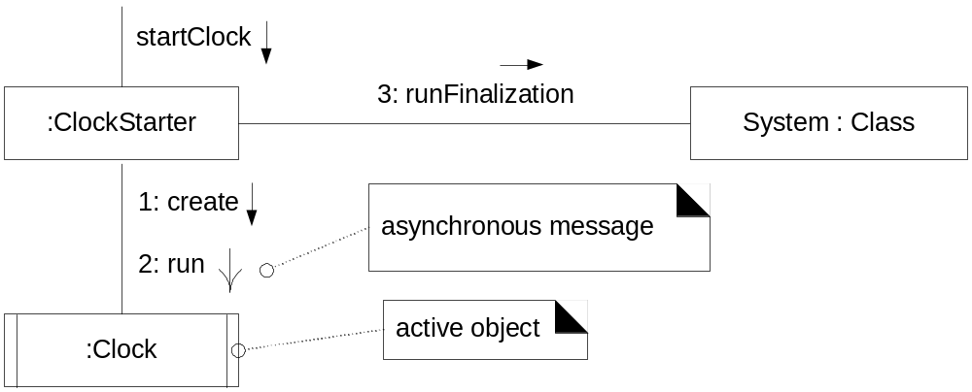
Asynchronous messages in communication diagrams
Notes:
Slide 3: Asynchronous Messages in Communication Diagrams
Key Points:
Asynchronous Messaging:
The sender does not wait for the receiver to complete its task.
Represented by a stick arrow in the diagram.
Diagram Details:
:ClockStarter sends startClock to :Clock.
:Clock begins its task (runs asynchronously).
The final runFinalization is sent to the system to finalize the process.
Active Object:
:Clock is an active object that runs on its own thread.
English Explanation:
Asynchronous messaging is commonly used in multi-threaded systems to improve efficiency. An active object manages its own execution, allowing the sender to continue without delay.

Slide 48
How to choose between using a sequence or communication diagram
Sequence diagrams
  Make explicit the time ordering of the interaction
    Use cases make time ordering explicit too
    So sequence diagrams are a natural choice when you build an interaction model from a use case
  Make it easy to add details to messages
    Communication diagrams have less space for this
Notes:
Slide 1: Choosing Sequence Diagrams
Key Points:
Time Ordering:
Sequence diagrams clearly represent the time order of interactions.
They align naturally with use cases, which also focus on time-dependent interactions.
Details in Messages:
Sequence diagrams make it easier to add detailed information to messages.
Communication diagrams, on the other hand, have less space for adding such details.

Slide 49
How to choose between using a sequence or communication diagram
Communication diagrams
  Can be seen as a projection of the class diagram
    Might be preferred when you are deriving an interaction diagram from a class diagram.
    Are also useful for validating class diagrams.
Notes:
Slide 2: Choosing Communication Diagrams
Key Points:
Projection of Class Diagrams:
Communication diagrams can be viewed as a projection of a class diagram.
Useful when deriving an interaction diagram from class structure.
Validation:
Communication diagrams are effective for validating class diagrams.
They ensure the relationships and associations between classes are correctly modeled.

Slide 50
Behavior Model: State Diagrams
A state diagram describes the behaviour of a system, some part of a system, or an individual object
  At any given point in time, the system or object is in a certain state
    Being in a state means that it behaves in a specific way in response to any events that occur
  Some events will cause the system to change state
    In the new state, the system will behave in a different way to events
  A state diagram is a directed graph where the nodes are states and the arcs are transitions
Notes:
Slide 1: Behavior Model – State Diagrams
Key Points:
Definition:
A state diagram models the behavior of a system, subsystem, or object over time by showing the states it can be in and how it transitions between these states.
States:
A state represents a condition where the system or object behaves in a specific way in response to events.
Transitions:
Events cause the system to transition from one state to another.
After transitioning, the system may behave differently in the new state.
Graph Structure:
Nodes represent states.
Arcs represent transitions triggered by events.
English Explanation:
State diagrams provide a dynamic view of a system. They help visualize:
How a system reacts to events.
What triggers state changes and what behavior changes occur as a result.
Example: In a vending machine:
States: Waiting for payment, dispensing item, idle.
Transitions: Payment received, item dispensed.

Slide 51
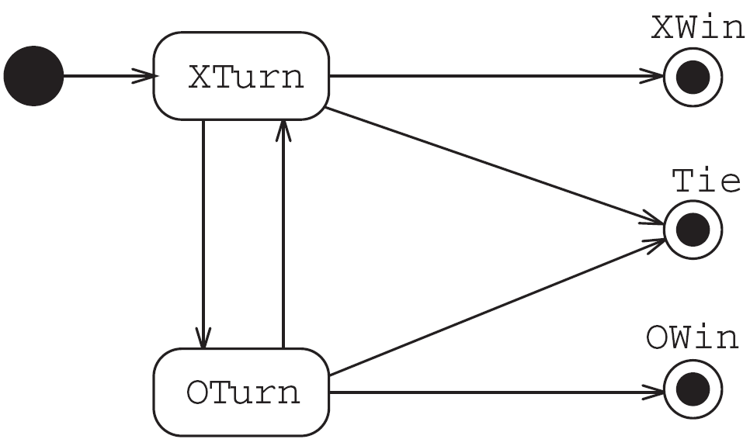
State diagrams – an example
  Tic-tac-toe game (also called noughts and crosses)
Notes:
Slide 2: State Diagram Example (Tic-Tac-Toe)
Key Points:
Context:
The example models the states of a Tic-Tac-Toe (Noughts and Crosses) game.
States:
XTurn: Player X's turn.
OTurn: Player O's turn.
End states: XWin, OWin, Tie.
Transitions:
Moves alternate between X and O (XTurn → OTurn).
Depending on the game outcome, the states transition to:
XWin: If Player X wins.
OWin: If Player O wins.
Tie: If the game ends in a draw.
English Explanation:
This diagram models the flow of a game based on player turns and outcomes:
Transitions: Player actions trigger state changes (e.g., from XTurn to OTurn).
End States: The game concludes in one of three outcomes.
Example:
X plays a move → O's turn → Repeat until a win or tie.

Slide 52
States
At any given point in time, the system is in one state
It will remain in this state until an event occurs that causes it to change state
A state is represented by a rounded rectangle containing the name of the state
Special states:
  A black circle represents the start state
  A circle with a ring around it represents an end state
Notes:
Slide 1: States
Key Points:
Definition:
At any time, a system is in one specific state.
It will remain in that state until an event triggers a transition to a different state.
Representation:
A state is shown as a rounded rectangle containing the state's name.
Special States:
Start state: Represented by a black circle.
End state: Represented by a circle with a ring around it.
English Explanation:
States define the behavior of a system at a specific time. The system remains in one state until an event causes it to move to another state.
Example:
A washing machine:
States: Idle, Washing, Rinsing, Spinning.
Start state: Idle.
End state: Completed.

Slide 53
Transitions
A transition represents a change of state in response to an event
  It is considered to occur instantaneously
The label on each transition is the event that causes the change of state
Notes:
Slide 2: Transitions
Key Points:
Definition:
A transition represents a state change in response to an event.
Transitions are instantaneous.
Labeling:
Each transition is labeled with the event that causes the state change.
English Explanation:
Transitions show how a system moves from one state to another. They are triggered by events, and the labels on transitions explain what caused the change.
Example:
In an elevator:
Event: Button pressed → Transition from "Idle" to "Moving."

Slide 54
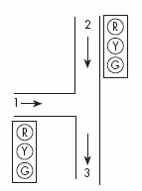
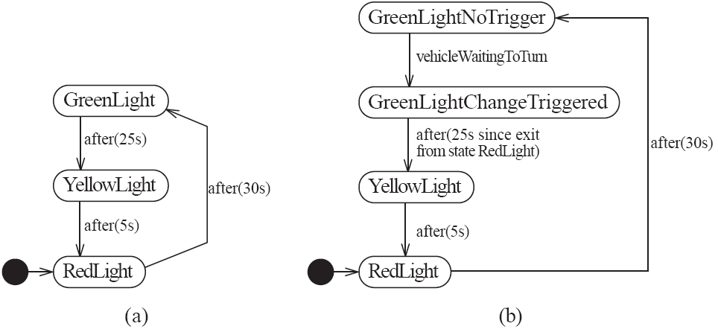
State diagrams – an example of transitions with time-outs
Notes:
Slide 3: State Diagram Example with Time-Outs
Key Points:
Traffic Light System:
States: GreenLight, YellowLight, RedLight.
Transitions:
GreenLight → YellowLight: After 25 seconds.
YellowLight → RedLight: After 5 seconds.
RedLight → GreenLight: After 30 seconds.
Enhanced Example:
Includes conditions like vehicleWaitingToTurn for more complex behaviors.
English Explanation:
State diagrams with time-outs model time-dependent behaviors, such as traffic lights. The system changes states after specific time intervals or based on conditions.
Use Case:
Traffic management systems, ensuring timed signal changes.

Slide 55
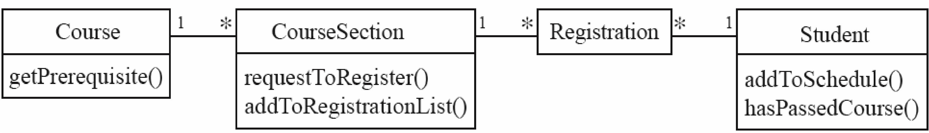
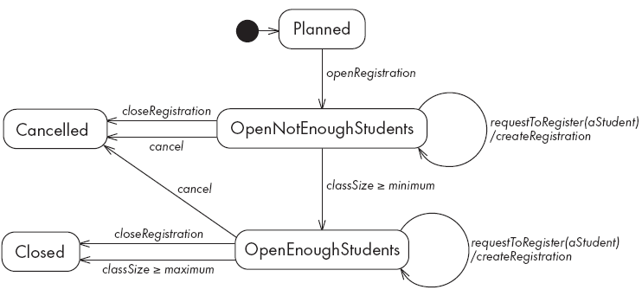
State diagrams – an example with conditional transitions
  State diagram of the CourseSection class
Notes:
Slide 4: State Diagram Example with Conditional Transitions
Key Points:
Course Registration:
States:
Planned → OpenNotEnoughStudents → OpenEnoughStudents → Closed or Cancelled.
Conditional Transitions:
Transitions depend on conditions like:
classSize >= minimum → Move to OpenEnoughStudents.
cancel → Move to Cancelled.
English Explanation:
This diagram shows conditional transitions for a course registration system:
If enough students enroll, the state transitions to OpenEnoughStudents.
If canceled, it transitions to Cancelled.
Use Case:
Academic systems for managing course registrations.

Slide 56
Activities in state diagrams
An activity is something that takes place while the system is in a state
  It takes a period of time
  The system may take a transition out of the state in response to completion of the activity,
  Some other outgoing transition may result in:
    The interruption of the activity, and
    An early exit from the state
Notes:
Slide 1: Activities in State Diagrams
Key Points:
Definition:
An activity is something that occurs while a system is in a specific state.
Activities take a period of time.
Transitions:
The system may transition out of the state after the activity finishes.
Other transitions may interrupt the activity or cause an early exit from the state.
English Explanation:
Activities represent ongoing processes in a state. For example, during a washing machine's "Washing" state, the activity could be the spinning of clothes. When the washing completes, the system transitions to the next state (e.g., "Rinsing").

Slide 57
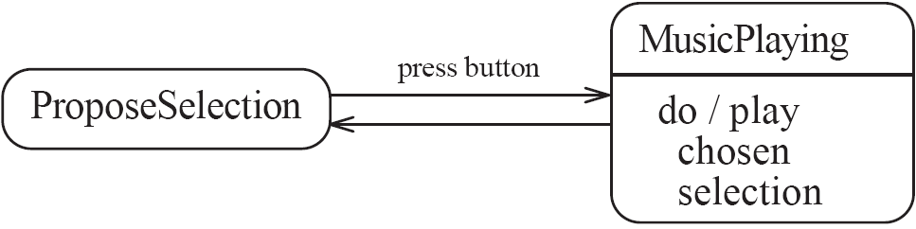
State diagram – an example with activity
State diagram for a Jukebox, illustrating an activity in a state
Notes:
Slide 2: State Diagram Example with Activity
Diagram Description:
States:
ProposeSelection: The user selects a song.
MusicPlaying: The jukebox plays the selected song.
Transition:
From ProposeSelection to MusicPlaying occurs when the button is pressed.
Activity in MusicPlaying: do/play chosen selection.
English Explanation:
This diagram models a jukebox:
The user selects a song in the ProposeSelection state.
When the button is pressed, the system transitions to MusicPlaying and plays the song.

Slide 58
Actions in state diagrams
An action is something that takes place effectively instantaneously
  When a particular transition is taken,
  Upon entry into a particular state, or
  Upon exit from a particular state
An action should consume no noticeable amount of time
Notes:
Slide 3: Actions in State Diagrams
Key Points:
Definition:
An action occurs almost instantaneously.
It happens:
During a transition,
Upon entering a state, or
Upon exiting a state.
Duration:
An action should not take noticeable time.
English Explanation:
Actions are quick events that occur when entering or leaving a state, or during a transition. For example:
An elevator opens doors when entering the "Idle" state.

Slide 59
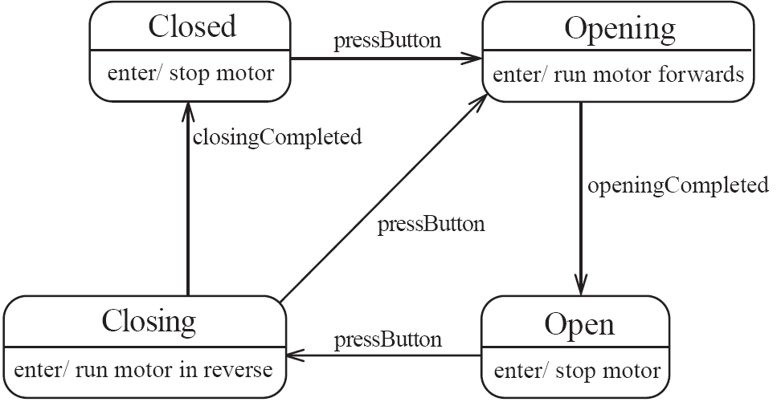
State diagram – an example with actions
State diagram for a garage door opener
Notes:
Slide 4: State Diagram Example with Actions
Diagram Description:
System: Garage Door Opener.
States:
Closed: Motor stops.
Opening: Motor runs forward.
Open: Motor stops.
Closing: Motor runs in reverse.
Transitions:
Button press triggers transitions:
Closed → Opening → Open.
Open → Closing → Closed.
English Explanation:
This state diagram models the behavior of a garage door opener:
When closed, pressing the button moves it to Opening.
Once opened, pressing the button again starts Closing.

Slide 60
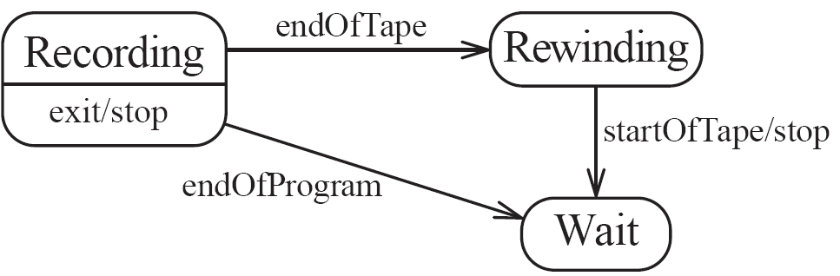
State diagrams – another example
Partial state diagram for a tape recorder
Notes:
Slide 5: Another State Diagram Example
Diagram Description:
System: Tape Recorder.
States:
Recording: Records until the end of the program or tape.
Rewinding: Tape rewinds.
Wait: The system pauses after rewinding.
Transitions:
Recording → Rewinding: When the tape ends.
Rewinding → Wait: When rewinding finishes.
English Explanation:
This models a tape recorder:
The system transitions from Recording to Rewinding when the tape ends.
It transitions to Wait after rewinding.

Slide 61
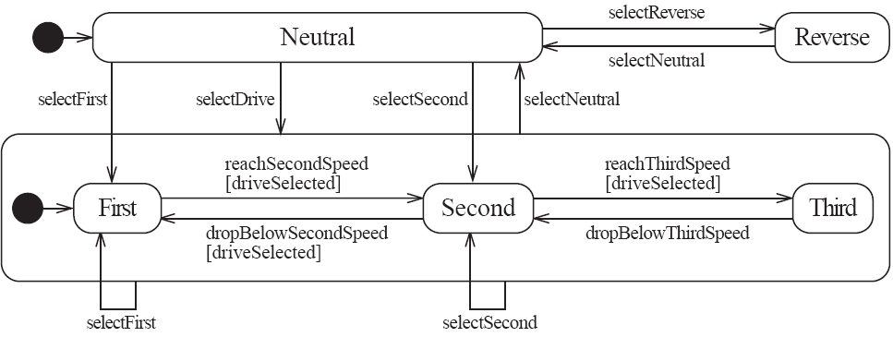
Nested substates and guard conditions
A state diagram can be nested inside a state.
  The states of the inner diagram are called substates.
State diagram for a car’s automatic transmission
Notes:
Slide: Nested Substates and Guard Conditions
This slide explains that a state diagram can have nested states, also known as substates, to represent more complex behavior within a single state.
Diagram Explanation (Car’s Automatic Transmission):
Outer States: The high-level states include Neutral, Reverse, and a compound state labeled Drive.
Substates: Within Drive, there are three substates: First, Second, and Third.
Transitions between substates are guarded by conditions like:
reachSecondSpeed[driveSelected] (move from First to Second when second speed is reached and the drive is selected).
dropBelowSecondSpeed[driveSelected] (move back to First when speed drops below the threshold).
These nested substates represent finer-grained behavior within the Drive state.
This structure enables modularity and reusability in modeling complex systems.

Slide 62
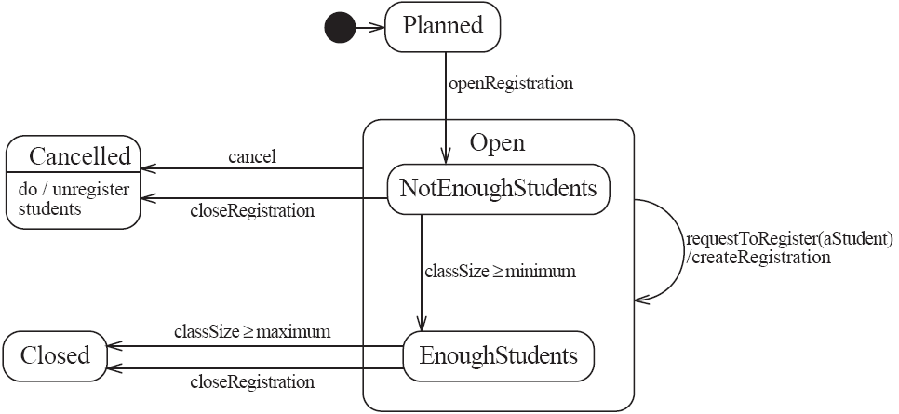
State diagram – an example with substates
State diagram of the CourseSection class
Notes:
Slide: State Diagram with Substates Example (Course Section)
Context:
This diagram models the state transitions for a CourseSection class, incorporating substates for the Open state.
Diagram Details:
Outer States: The high-level states include:
Planned: Initial state where the course section is not yet open for registration.
Cancelled: Course is cancelled, and students are unregistered.
Closed: Course is fully enrolled and cannot accept more registrations.
Substates in Open:
NotEnoughStudents: This substate indicates that the course has not yet reached the minimum required number of students.
EnoughStudents: This substate indicates the course has the minimum number of students required to proceed.
Transition between these substates depends on the class size:
classSize >= minimum moves to EnoughStudents.
classSize < minimum moves to NotEnoughStudents.
Using substates here simplifies the representation of conditions within the Open state.

Slide 63
Behavior model: Activity Diagrams
An activity diagram is like a state diagram
  Except most transitions are caused by internal events, such as the completion of a computation
An activity diagram
  Can be used to understand the flow of work that an object or component performs
  Can also be used to visualize the interrelation and interaction between different use cases
  Is most often associated with several classes
One of the strengths of activity diagrams is the representation of concurrent activities
Notes:
Behavior Model: Activity Diagrams
Definition and Usage:
Activity diagrams are like state diagrams but focus on modeling workflows triggered by internal events like computation completion.
They represent the flow of tasks performed by a system, showing interactions between use cases and components.
Useful for showing concurrent activities and dependencies among processes.

Slide 64
Representing concurrency
Concurrency is shown using forks, joins and rendezvous
  A fork has one incoming transition and multiple outgoing transitions
    The execution splits into multiple concurrent threads
  A join has multiple incoming transitions and one outgoing transition
    The outgoing transition will be taken when all incoming transitions have been triggered
    The incoming transitions must be triggered in separate threads
    If one incoming transition occurs, a wait condition occurs at the join until the other transitions occur
Notes:
Representing Concurrency:
Concurrency Mechanisms:
Fork:
A single incoming transition splits into multiple outgoing transitions, representing parallel execution.
Join:
Multiple incoming transitions synchronize to a single outgoing transition.
All incoming transitions must be triggered before proceeding.

Slide 65
Representing concurrency
A rendezvous has multiple incoming and multiple outgoing transitions
  Once all the incoming transitions are triggered, the system takes all the outgoing transitions, each in a separate thread
Notes:
Rendezvous:
Combines multiple incoming and outgoing transitions.
All incoming transitions are triggered before all outgoing transitions are executed.

Slide 66
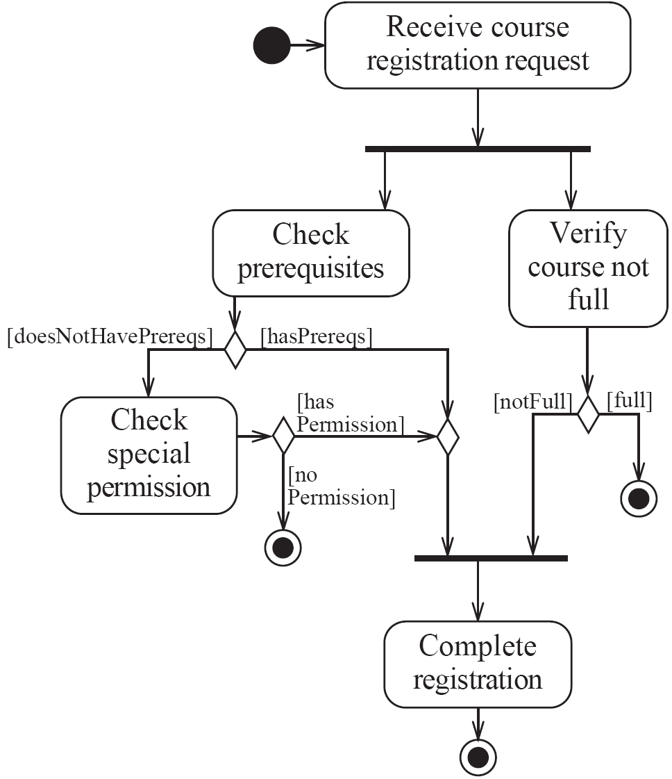
Activity diagrams – an example
  Activity diagram of a registration process
Notes:
Diamonds: decision node and merge node.
Example Activity Diagram:
Course Registration Process:
Start with a "Receive Course Registration Request."
Decision points like Check Prerequisites or Verify Course Not Full evaluate conditions (e.g., doesNotHavePrereqs, notFull).
Actions like Check Special Permission or completing the registration follow based on these conditions.
Black circles indicate start and end of processes.

Slide 67
Swimlanes
Activity diagrams are most often associated with several classes
  The partition of activities among the existing classes can be explicitly shown using swimlanes
Notes:
Swimlanes in Activity Diagrams
Definition:
Swimlanes partition activities across different classes or entities.
They help organize and visualize which class or entity is responsible for a particular activity.

Slide 68
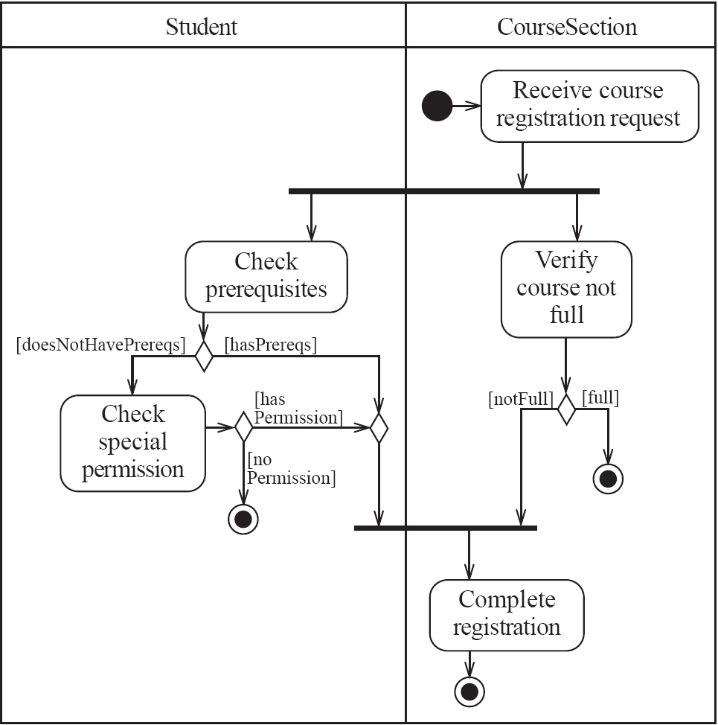
Activity diagrams – an example with swimlanes
Notes:
Example Diagram:
Vertical Swimlanes: The "Student" and "CourseSection" columns in the diagram separate the responsibilities.
Flow:
The "Student" initiates a request (e.g., "Check prerequisites").
The "CourseSection" verifies the course and determines its status.
The swimlanes visually show the interactions between these two entities and the responsibilities of each.

Slide 69
Implementing classes based on Interaction Diagrams and Behavior Models
You should use these diagrams for the parts of your system that you find most complex
  I.e., not for every class
Interaction, activity and state diagrams help you create a correct implementation
This is particularly true when behaviour is distributed across several use cases
  E.g.. a state diagram is useful when different conditions cause instances to respond differently to the same event
Notes:
Implementing Classes Based on Interaction Diagrams and Behavior Models
Key Points:
Use diagrams like interaction, activity, and state diagrams selectively for complex parts of the system.
These diagrams clarify behavior and ensure correct implementation.
Especially useful when the same event triggers different responses under different conditions.
Examples:
State Diagrams: Useful for capturing how an object transitions between states based on events.
Activity Diagrams: Ideal for workflows involving multiple classes or components.
In summary, these slides emphasize using diagrams to partition responsibilities clearly (via swimlanes) and to implement correct behaviors in complex scenarios. This ensures a better understanding of system dynamics and interactions.

Slide 70
Example
Notes:
Top Part: Sequence Diagram (Interaction Diagram)
Purpose: Demonstrates the interactions between system components during the course registration process, focusing on method calls and object communication.
Components:
Actors and Objects:
Actor (GUI): Represents the user interface where the user initiates the registration.
Objects:
CourseSection: Manages the registration process and checks prerequisites.
Registration: Represents the actual registration record.
Student: The student object that interacts with the registration.
Course: Provides information like prerequisites.
Process Flow:
The GUI sends a requestToRegister to CourseSection.
CourseSection validates the prerequisites for the course by checking hasPrerequisite and whether the student has passed the required course (hasPassedCourse).
If prerequisites are satisfied (opt block indicates an optional check), a Registration object is created and added to the student's schedule via addToSchedule.
Bottom Part: State Diagram (Behavior Model)
Purpose: Describes the possible states and transitions of the CourseSection class during the registration process.
Components:
States:
Planned: The course section is planned but not yet open for registration.
Open: Registration is open.
Substates:
NotEnoughStudents: The minimum number of students hasn’t been met.
EnoughStudents: The minimum number of students has been reached.
Cancelled: The course is canceled, and students are unregistered.
Closed: Registration is closed as the class is full.
Transitions:
openRegistration: Transitions from Planned to Open.
Within Open:
If classSize >= minimum, it moves to EnoughStudents.
If fewer students register, it remains in NotEnoughStudents.
closeRegistration: Transitions EnoughStudents to Closed.
cancel: Cancels the course and moves to Cancelled.
Integration of Interaction and Behavior Models:
The Sequence Diagram highlights the interactions and method calls to manage the registration.
The State Diagram shows how the system transitions through different states based on the course's registration status and class size conditions.
Together, they offer a complete view of both dynamic interactions (how objects communicate) and state changes(how the system evolves).

Slide 71
Example
public class CourseSection{
private Course course;
private Collection <Registration> registrationList;
public CourseSection(Course c){…}
…
}
Notes:
Class Diagram for CourseSection
Purpose: This shows the relationships between the classes Course, CourseSection, Registration, and Student.
CourseSection holds a reference to Course.
A CourseSection can have many Registration objects, representing students enrolled.
A Registration object connects a Student to a CourseSection.
Code Example:
The CourseSection class has fields for Course, a collection of Registration, and helper methods to manage states.

Slide 72
Example
public class CourseSection{
private Course course;
private Collection <Registration> registrationList;
private boolean open = false;
private boolean closedOrCanceled = false;
….
}
Notes:
State Diagram for CourseSection
States:
Planned: Registration not yet open.
Open: Accepting registrations, with substates:
NotEnoughStudents: Fewer students than the minimum.
EnoughStudents: Meets or exceeds the minimum.
Cancelled: No students registered.
Closed: Registration is closed (section full or class taught).
Transitions:
openRegistration: Moves from Planned to Open.
closeRegistration: Moves to Closed or Cancelled based on conditions.
cancel: Cancels the section and unregisters all students.

Slide 73
Example
States:
  ‘Planned’:
    closedOrCancelled == false && open == false
  ‘Cancelled’:
    closedOrCancelled == true && registrationList.size() == 0
  ‘Closed’ (course section is too full, or being taught):
    closedOrCancelled == true && registrationList.size() > 0
Notes:
State Representation in Code
State Variables:
open: Boolean indicating if registration is open.
closedOrCanceled: Boolean for if the section is closed or canceled.
State Logic:
Planned: closedOrCanceled == false && open == false.
Cancelled: closedOrCanceled == true && registrationList.size() == 0.
Closed: closedOrCanceled == true && registrationList.size() > 0.
Methods:
openRegistration: Transitions to NotEnoughStudents.
closeRegistration: Moves to Cancelled if the list size is less than the minimum, otherwise Closed.
cancel: Cancels the section and clears the registration list.

Slide 74
Example
States:
  ‘Open’ (accepting registrations):
    open == true
  ‘NotEnoughStudents’ (substate of ‘Open’):
    open == true &&
    registrationList.size() < course.getMinimum()
  ‘EnoughStudents’ (substate of ‘Open’):
    open == true &&
    registrationList.size() >= course.getMinimum()

Slide 75
Example: the CourseSection class
public CourseSection(Course course){
this.course = course;
registrationList = new LinkedList<Registration>();
…
}
public void openRegistration(){
if(!closedOrCanceled && !open) // must be in 'Planned' state
{
open = true; // to 'NotEnoughStudents' state
}
}

Slide 76
Example: The CourseSection class
public void closeRegistration(){
if (open) {
open = false;
closedOrCanceled = true;
if (registrationList.size() < course.getMinimum()){
unregisterStudents(); // to 'Canceled' state
}
}
}
public void cancel(){
if (open){
open = false;
closedOrCanceled = true;
unregisterStudents();
}
}

Slide 77
Example
public void requestToRegister(Student aStudent) {
if (open) { // must be in one of the two 'Open' states
Course prereq = course.getPrerequisite();
bool hasPrerequisite = aStudent.hasPassedCourse(prereq);
if (hasPrerequisite) {
// Indirectly calls addToRegistrationList
new Registration(this, aStudent);
}
// Check for automatic transition to 'Closed' state
if (registrationList.size() >= course.getMaximum()) {
// to 'Closed' state
open = false;
closedOrCanceled = true;
}
}
}
Notes:
Behavior Example
requestToRegister Method:
Validates if open == true.
Checks prerequisites using getPrerequisite from Course and hasPassedCourse from Student.
Creates a Registration if prerequisites are met.
Closes registration automatically if the maximum size is reached.
unregisterStudents Method:
Iterates through the registration list and removes each Registration.

Slide 78
Example: the CourseSection class
// Private method to remove all registrations
// Activity associated with 'Canceled' state.
private void unregisterStudents()
{
Iterator it = registrationList.iterator();
while (it.hasNext())
{
Registration r = (Registration)it.next();
r.unregisterStudent();
it.remove();
}
}
// Called within this package only, by the constructor of
// Registration to ensure the link is bi-directional
void addToRegistrationList(Registration newRegistration)
{
registrationList.add(newRegistration);
}
}
Notes:
Combined Interaction and Behavior Model
Sequence Diagram:
A Student requests to register via the GUI.
The CourseSection checks prerequisites by querying the Course and Student.
If valid, a Registration is created, added to the list, and linked bidirectionally.
State Diagram:
Depicts transitions based on the open state and registration count.
Substates in Open show whether the class meets the minimum size requirement.

Slide 79
Difficulties and risks in modeling interactions and behaviour
Dynamic modelling is a difficult skill
  In a large system there are a very large number of possible paths a system can take.
  It is hard to choose the classes to which to allocate each behaviour:
    Ensure that skilled developers lead the process, and ensure that all aspects of your models are properly reviewed.
    Work iteratively:
      Develop initial class diagrams, use cases, responsibilities, interaction diagrams and state diagrams;
      Then go back and verify that all of these are consistent, modifying them as necessary.
    Drawing different diagrams that capture related, but distinct, information will often highlight problems.
Notes:
Slide 1: Difficulties and Risks in Modeling Interactions and Behavior
Dynamic Modeling Complexity:
Dynamic modeling involves creating representations of a system's behavior, which can become highly intricate in large systems due to the numerous possible paths.
Allocating behaviors to appropriate classes is particularly challenging.
Best Practices to Address These Challenges:
Skilled Developers: Ensure that experienced developers lead the modeling process and perform rigorous reviews of the models.
Iterative Work:
Begin with initial drafts of class diagrams, use cases, responsibilities, interaction diagrams, and state diagrams.
Revisit and validate the models to ensure consistency and make modifications as necessary.
Multiple Diagrams: Using various diagrams to represent different but related aspects of the system often helps uncover potential problems.

Slide 80
For More Information
Pleas find the following book in the ‘ebooks’ section of the library
  “Applying UML and Patterns: An Introduction to Object-Oriented Analysis and Design and Iterative Development, Third Edition, Craig Larman, Prentice Hall, 0-13-148906-6
AND
Read Chapter 14 for UML Interaction Diagrams
Read Chapter 28 for UML Activity Diagrams
Read Chapter 30 for UML State Diagrams
Notes:
Slide 2: For More Information
Suggested Resource:
The book "Applying UML and Patterns: An Introduction to Object-Oriented Analysis and Design and Iterative Development" by Craig Larman (Third Edition).
This book provides foundational knowledge about UML and its use in iterative development.
Chapters of Interest:
Chapter 14: Focuses on UML Interaction Diagrams (e.g., sequence and communication diagrams).
Chapter 28: Covers UML Activity Diagrams, which are used to model workflows and concurrent activities.
Chapter 30: Discusses UML State Diagrams, emphasizing state transitions and behavior modeling.

